Slide 1

Use Case 3: Unified Social Registry for Enhanced Delivery of Public Welfare Services

Slide 2


Knowledge Graph Fraud Intelligence
How Advance-RAG explains, prioritizes, and operationalizes fraud risk
Presentation Scope
storge
dn
hub
Fraud Backbone Architecture
Research Chat: Grounded investigative narratives
Knowledge Map: Entity topology & evidence paths
Social Registry: Operational triage dashboard
Raw Dump srsdb.dump
Relational PostgreSQL
Graph Neo4j
Presentation deck with live frontend screenshots | April 2026

Slide 3
Data Source Clarity
Unstructured Pipeline
Structured Pipeline
Uploaded Documents
Converts raw text into structured insights via:
Research Chat
Document Knowledge Graph (KG)
Social Registry Dump
Drives the primary operational engine:
Graph Intelligence
Fraud Operations Dashboard
*Primary power for detection and triage
Advance-RAG | KG Fraud Intelligence

Slide 4
Fraud Intelligence Rules Engine
Rule
Trigger
Confidence
Edge Created
A1
Age > 110
85%
FLAGGED_AS → FraudFlag(GHOST)
A2
DOB in future
90%
FLAGGED_AS → FraudFlag(GHOST)
B1
Exact name+DOB+GP
92%
POTENTIAL_DUPLICATE
B2
Fuzzy name (≥80%) + DOB + GP
78%
POTENTIAL_DUPLICATE
B3
5+ same DOB at GP
70%
SAME_DOB_AT_GP
B4
Cross-GP same name+DOB
65%
POTENTIAL_DUPLICATE
C1
GP > 15% of enrollments (min 50)
70%
HIGH_RISK_CLUSTER
C3
Enrollment before birth year
80%
FLAGGED_AS → FraudFlag(ANOMALY)
D1
Missing DOB
60%
FLAGGED_AS → FraudFlag(DATA_QUALITY)
D3
Duplicate scheme_beneficiary_id
88%
FLAGGED_AS → FraudFlag(DATA_QUALITY)
Advance-RAG | KG Fraud Intelligence

Slide 5
How Each Module Helps Users
Research Chat
Knowledge Map
Social Registry Dashboard
forum
account_tree
dashboard
Converts graph/document context into grounded investigative narratives.
Visualizes suspicious entity topology and evidence paths.
Turns graph signals into triage-ready operational workflows.
Advance-RAG | KG Fraud Intelligence

Slide 6
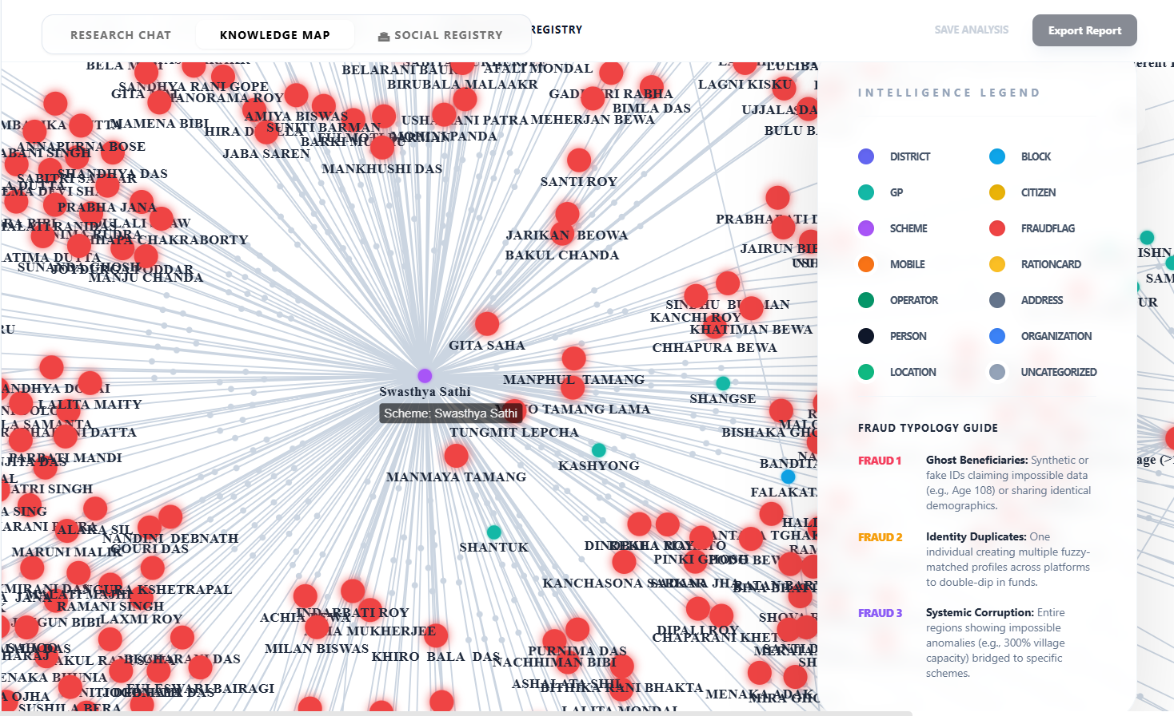
Knowledge Map: Graph Explainability
LIVE KNOWLEDGE GRAPH INTERFACE
error_outline
SUSPICIOUS ENTITIES
Red FraudFlag nodes highlight anomalies and connected risk clusters in real-time.
visibility
VISUAL INSPECTION
Analysts can visually trace hub patterns between schemes and primary beneficiaries.
Advance-RAG | KG Fraud Intelligence

Slide 7
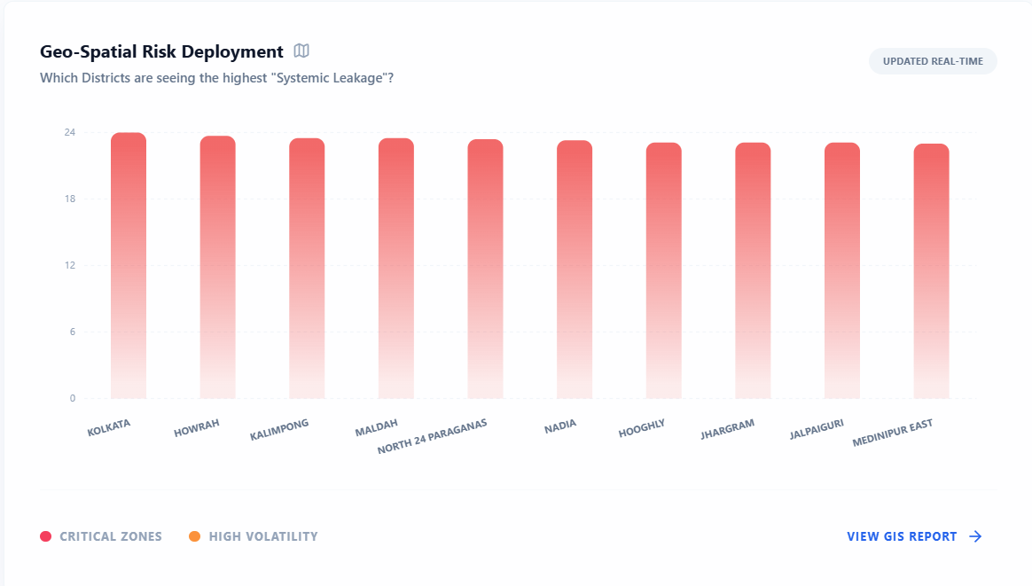
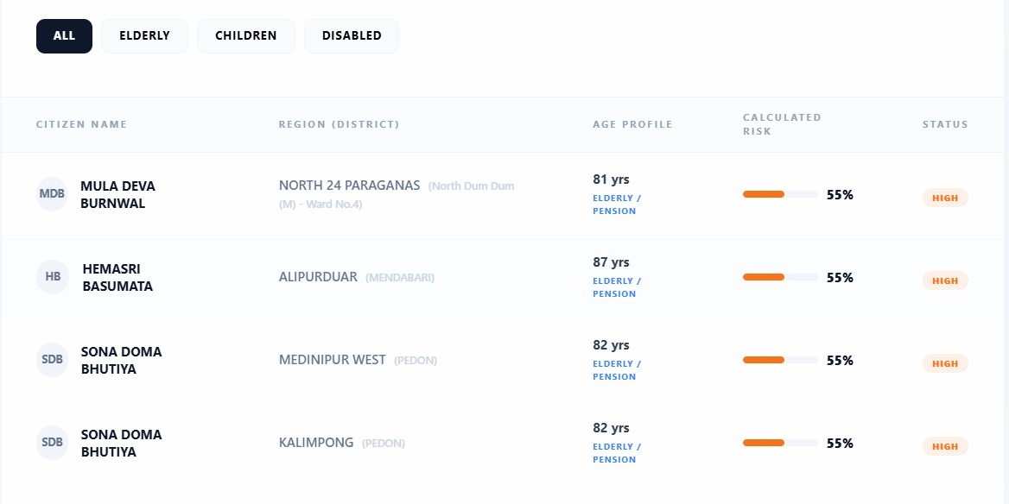
Dashboard Analytics: Risk Targeting and Segmentation
GEO-SPATIAL RISK DEPLOYMENT
LIFECYCLE VULNERABILITY
insights
KEY INSIGHTS
District-level risk distribution for last-mile targeting
Beneficiary segmentation by profile
Advance-RAG | KG Fraud Intelligence

Slide 8
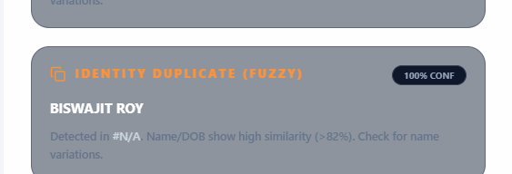
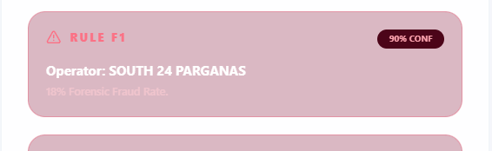
Intelligence Feed: Real-Time Fraud Signals
DUPLICATE IDENTITY ALERTS
feed
CONFIDENCE-TAGGED ANOMALIES
Unified feed surfaces confidence-tagged anomaly alerts for real-time risk assessment.
bolt
RAPID PRIORITIZATION
Supports rapid prioritization via fraud type and severity to optimize analyst focus.
OPERATOR CORRUPTION ALERTS (RULE F1)
Advance-RAG | KG Fraud Intelligence

Slide 9
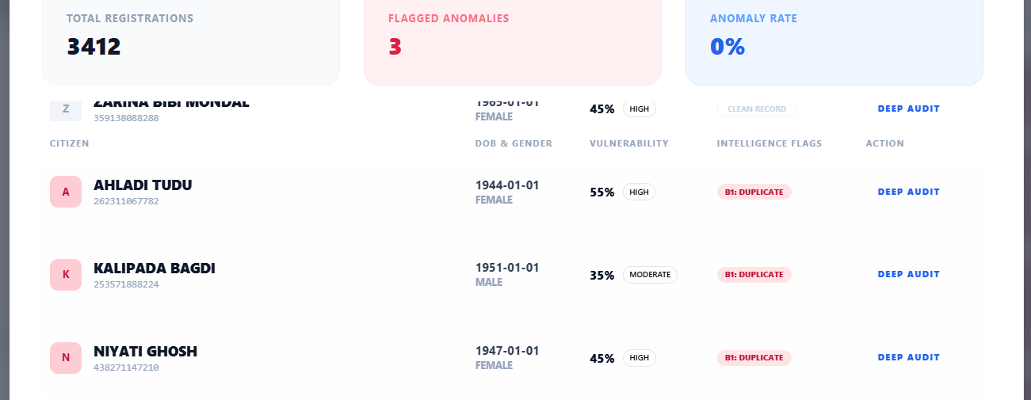
Forensic Drill-Down: Operator Audit Workspace
OPERATOR FORENSIC AUDIT MODAL
Advance-RAG | KG Fraud Intelligence

Slide 10
How Knowledge Graph Improves Fraud Prediction
GRAPH FEATURES
METHODOLOGY
BUSINESS RESULT
Network Intelligence
Duplicate edges
DOB clusters
Shared identity hubs
Operator anomaly rates
Risk Estimation
Graph-enhanced risk estimation replaces opaque black-box scoring.
hub
Efficiency & Clarity
Stronger precision
Better explainability
Lower false-positive operational burden
Advance-RAG | KG Fraud Intelligence

Slide 11
Operational Decision Flow
01
Alert
Real-time detection of suspicious anomalies.
02
Evidence
Trace KG entity topology and evidence paths.
03
Triage
Rapid prioritization based on risk severity.
04
Assign
Operational assignment to field audit teams.
05
Field
Physical verification and operator forensic audit.
06
Close
Final workflow closure or further escalation.
Advance-RAG | KG Fraud Intelligence

Slide 12
What Users and Leadership Get
INVESTIGATORS
PROGRAM TEAMS
LEADERSHIP KPIs
Grounded Intelligence
Explainable evidence paths
Faster case triage
Unified investigative narratives
psychology
Operational Oversight
District-level risk visibility
Operator-level risk analytics
Last-mile targeting distribution
groups
Performance Metrics
Precision & False-Positive Rate
Time-to-triage
SLA closure speed
Platform reliability
insights
Advance-RAG | KG Fraud Intelligence

Slide 13
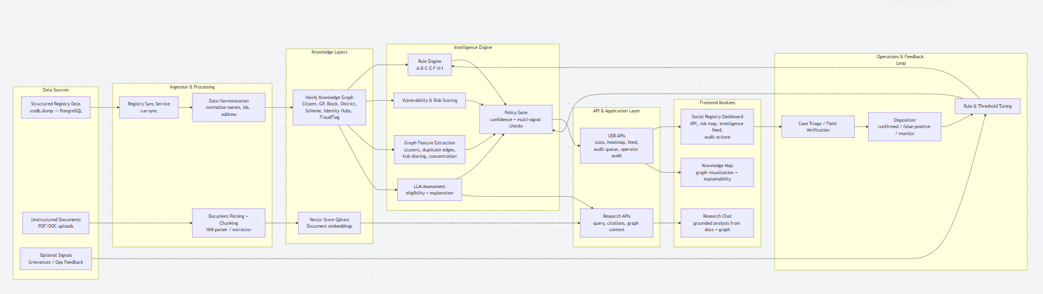
Architecture Flow

Slide 14
Discovery & Configuration Questionnaire
1. BUSINESS OUTCOMES
• Priority fraud patterns for this quarter?
• Primary Cost Driver: False Positives vs. Negatives?
• Key KPI: Leakage, Audit Speed, or Accuracy?
• Target metric for 90-day success?
2. DECISION POLICY
• Min confidence threshold for escalation?
• Multi-signal confirmation requirements?
• Policy Actions: Monitor, Investigate, Suspend?
• Final approver for high-severity actions?
3. DATA REPRESENTATION
• Is dump representative of production env?
• Data trust levels (Trusted vs. Noisy)?
• Source-of-truth for eligibility & policy?
• Delta/CDC update capability?
4. GOVERNANCE & PRIVACY
• RBAC PII masking requirements?
• Required alert & case log retention period?
• Social/Grievance data cross-linking rules?
• Mandatory regulatory reporting formats?
5. OPERATIONAL WORKFLOW
• Daily alert triage ownership?
• Team capacity vs. expected alert load?
• SLA: Time-to-triage & Time-to-closure?
• Feedback loop for false positives?
6. FRONTEND & UX
• Must-have: Dashboard, Queue, Geo View?
• Mandatory Exports: CSV, PDF, Summary?
• Critical Filter criteria (District, Severity)?
• Language & Localization requirements?
Advance-RAG | Client Discovery Questionnaire

Slide 15
Summary & Closing Statement
CORE INTELLIGENCE LAYER
Advance-RAG uses Knowledge Graph as the core explainable intelligence layer for fraud operations.
UNIFIED WORKFLOW
The platform unifies detection, visualization, and field-audit action in one workflow.
Advance-RAG | Knowledge Graph Fraud Intelligence

